Slide 1
Data Visualization
Service desk operations

Slide 2
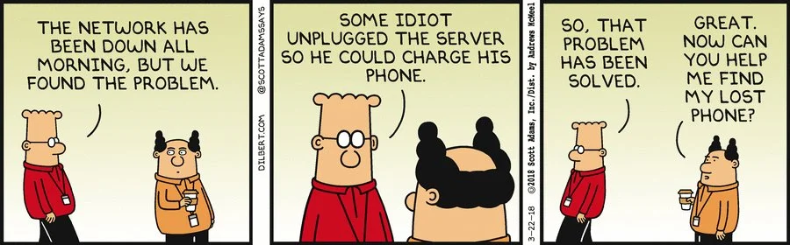
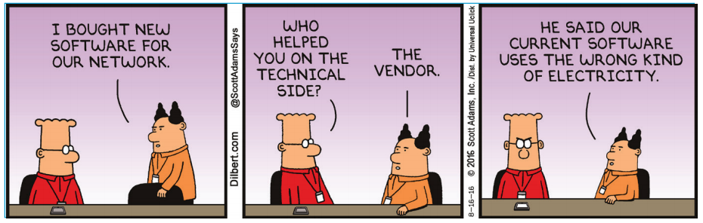
Problem Statement
Daunting task of resolving them quickly
Non-visibility into the entire resolution Workflow and Tracking
Work Load Management
Effectively Organize Service Desk
Tickets Categorization
Some findings were not relevant for their Domain or their company and missed important details
Important not only to keep track of tools and infrastructure when working on data
Improved our internal communication
One Day at work…
Next day at work…

Slide 3
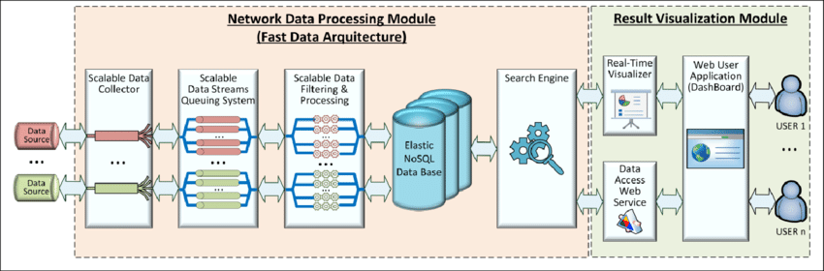
High Level Implementation Plan
We are collecting data and want to do something smart and we have a clear vision, while we map all the Business Processes and build our systems.
We needed to adjust our way of thinking if we hoped to bring AI projects successfully into Infrastructure Support Systems.
Perform exploratory analysis to gain key insights and identify firm conclusions, visualizations, and ideas for the future.

Slide 4
30 – 60 – 90 Day Implementation Plan
30 day
Observe and Learn
60 day
Act & Build
90 day
Sustain & Push
Main Objectives of the Project
Be Prepared for any event
Thrive to deliver the best
Analyze the failures
Rely on facts
Proactive approach to address critical issues

Slide 5
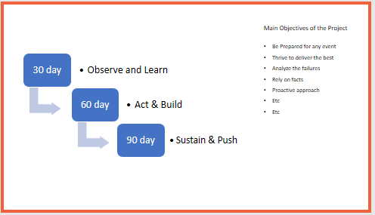


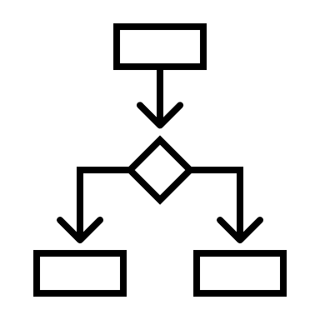
Detailed plan
30 Day
Set the baselines
60 Day
Define an action plan and deliver
90 Day
Short & Long term Project Management
Understand Team & Culture
Meet Team, Functions & Stakeholders
Learn Process, Procedures & Policies
Develop relationships with Teams, Functions & Stakeholders
Adapt Processes, Procedures & Policies
Push the Teams
Secure Teams, Functions & Stakeholders
Optimize Processes & review Procedures & Policies

Slide 6
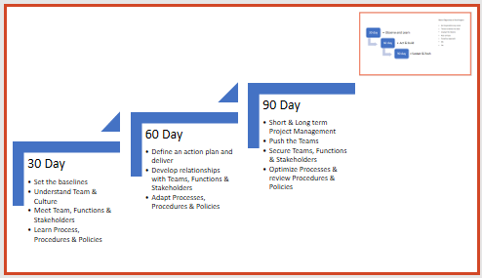

Gain Visibility (30 Day)
Analyze the current situation
Meet Customers
Secure early wins meaningful to the team
Get current status
Determine immediate problems to solve
Understand where each functional stakeholder stands
In terms of Management, Team Org., Process, Offerings
Meet Champion functional owners, gain feedback
Understand the lost opportunities and churned policies and procedures
Focus on 3~4 most critical wins to be secured
Involving the core team

Slide 7
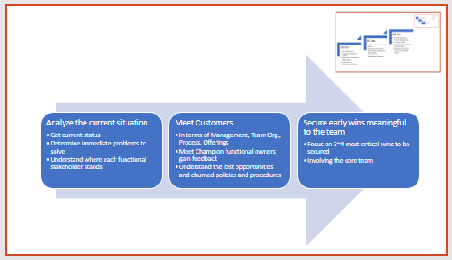
Learn more about the Team (30 Day)
Meet the Team & Stakeholders and Prepare Team Skills Inventory & Stakeholder Analysis (RACI)
Establish strengths and weaknesses chart & Identify gaps that need to be addressed (SWOT)
5 key questions
What are the biggest challenges?
Why is the team facing them ?
What are the most promising opportunities for resolution ?
What would need to happen for the team to exploit the potential for these opportunities ?
If you were me, what would you focus on ?
Learning Culture &
Management
Discuss activities With:
Top Global Account Directors / Top Management
Matrixed Cross Function managers and functional managers
Be open to suggestions and Best practices
Attend to people in person
Processes, Procedures, and Culture
Have complete understanding of applications, products and tools

Slide 8
Implement an Early Management Process (60 Day)
Book periodic meetings with the team
Operations Team
Management Team
Strategy Team
Development Team Use proactive and reactive indicators :
Roadmap planning
Building Business Processes
Overall function health
Reorganize and Empower Team
Implement an Early Management Process

Slide 9
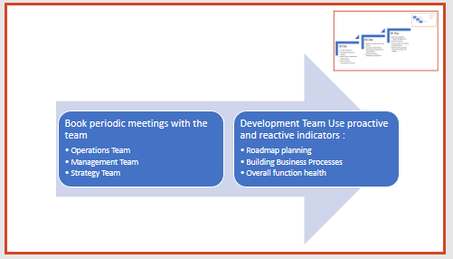
Define an Action Plan and Deliver (60 Day)
Fill the gaps identified
Operations
Project team
Production Support Team
Developers/Engineers
Business Analysts
Quality Analysts and testers
PM – Scrum Master, Project Managers, Product owners
Strategy – Executive Team
Make sure each member is at his right place
Support the team and begin to value and foster team spirit and synergy.
Operationally
Strategically Develop Relationships
Continuous feedback
Production basis
Supervising basis
Strategically
Organize events at the Customers’ site or in-house
Into customers services
Cross-networking
Attend professional organization meetings
Leverage the relation to be more strategic (if needed)
Developing Relationships

Slide 10

Short & Long Term Project Management (90 Day)
Identify Wins & Failures
Achieve
Obtain Feedback
Feedback on new process and policies
Procedures
Policy reviews
Communicate and review Change Management
Alignment of the Business Unit
Work on the concentrated effort
Key elements to Sync
Strategy
Structure
Skills &
Culture
Establish way to reward core team
Identify key challenges
Sustaining and implement other functions

Slide 11
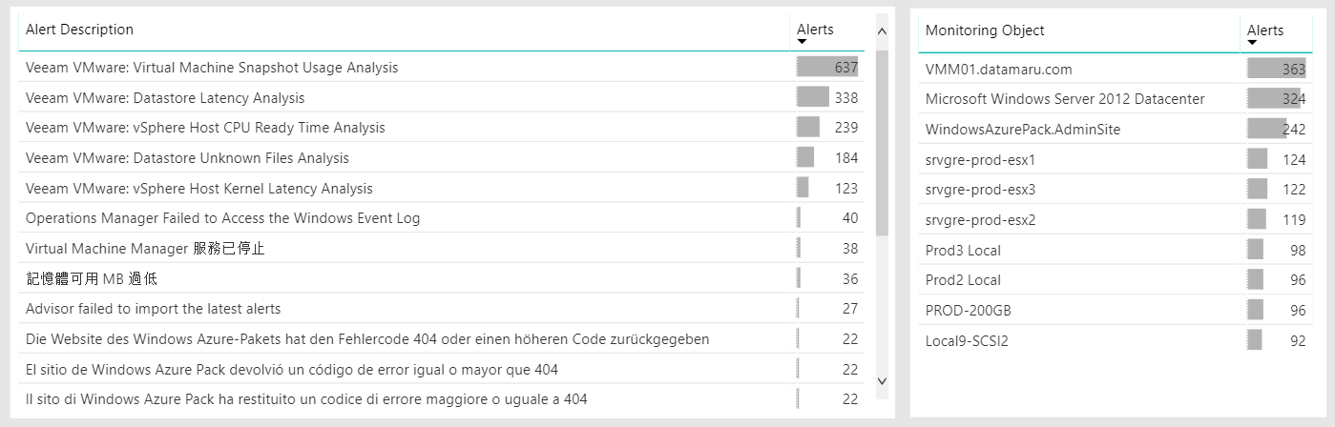
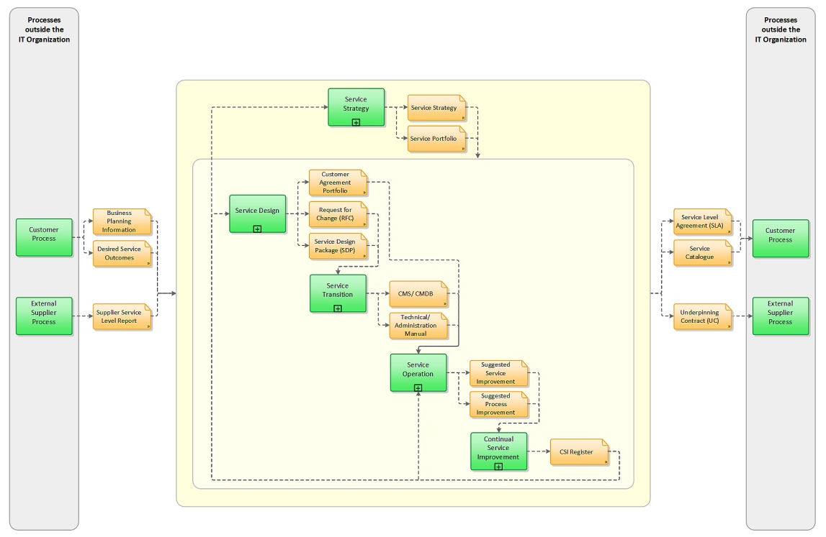
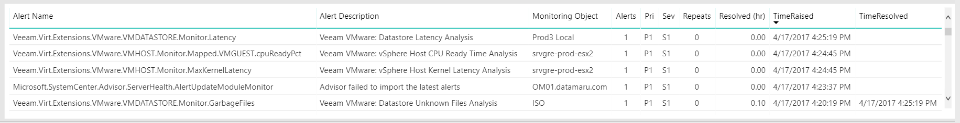

Single Dashboard – Critical Cockpit Wireframe
Page 1 – Screen 1
Selected Application or Server
Monitoring Services
Work-flow and Infra Setup
Monitoring Other details

Slide 12
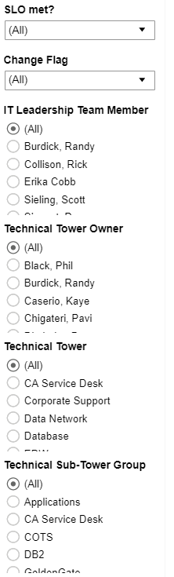
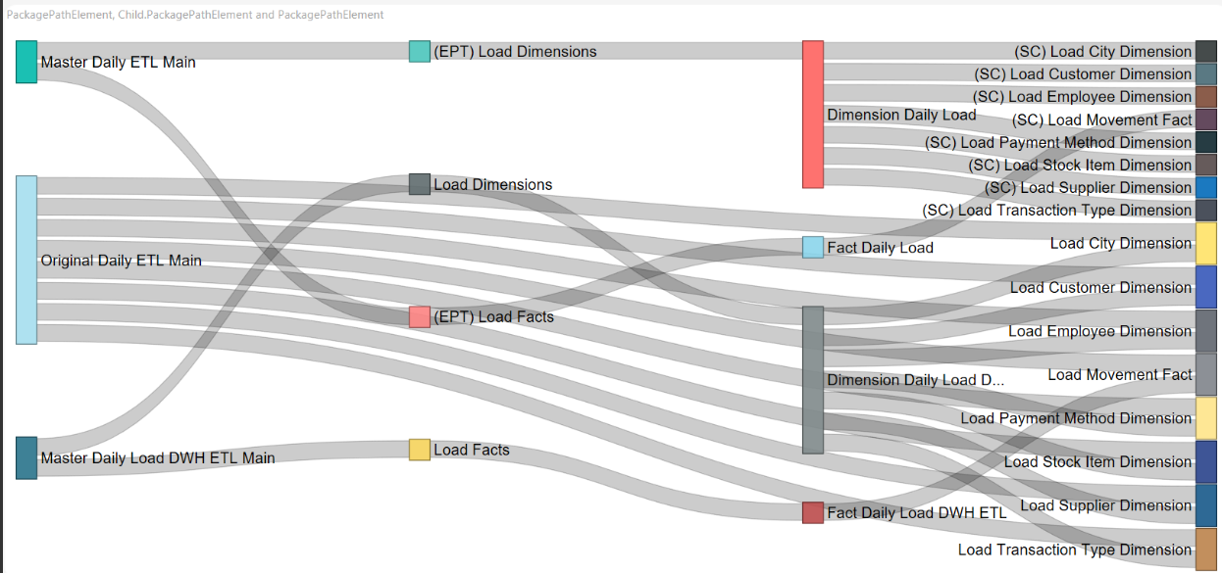
Single Dashboard – Critical Cockpit Wireframe
Page 1 – Screen 2

Slide 13
Thank you

